Slide 1
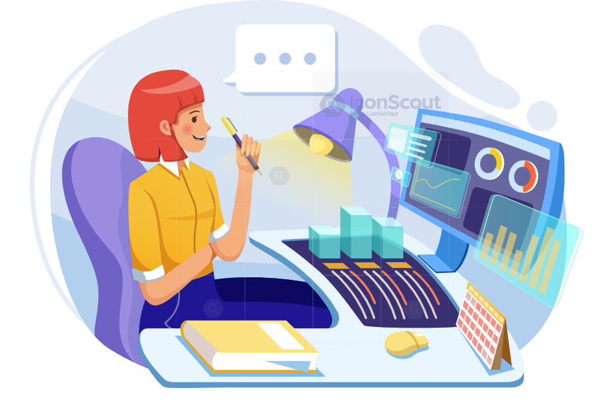
Advance Excel Project – “Google playstore Dashboard” – Presented By
“Nutan Zine”

Slide 2
Total App Rating of Donut Chart

Slide 3
Categorywise Count Of Type & Price - Column Chart

Slide 4
Percentage Of Reviews Of App - Radar Chart

Slide 5
Percentage Of Content Rating - Line Chart

Slide 6
Count Of App Version - Surface Chart

Slide 7
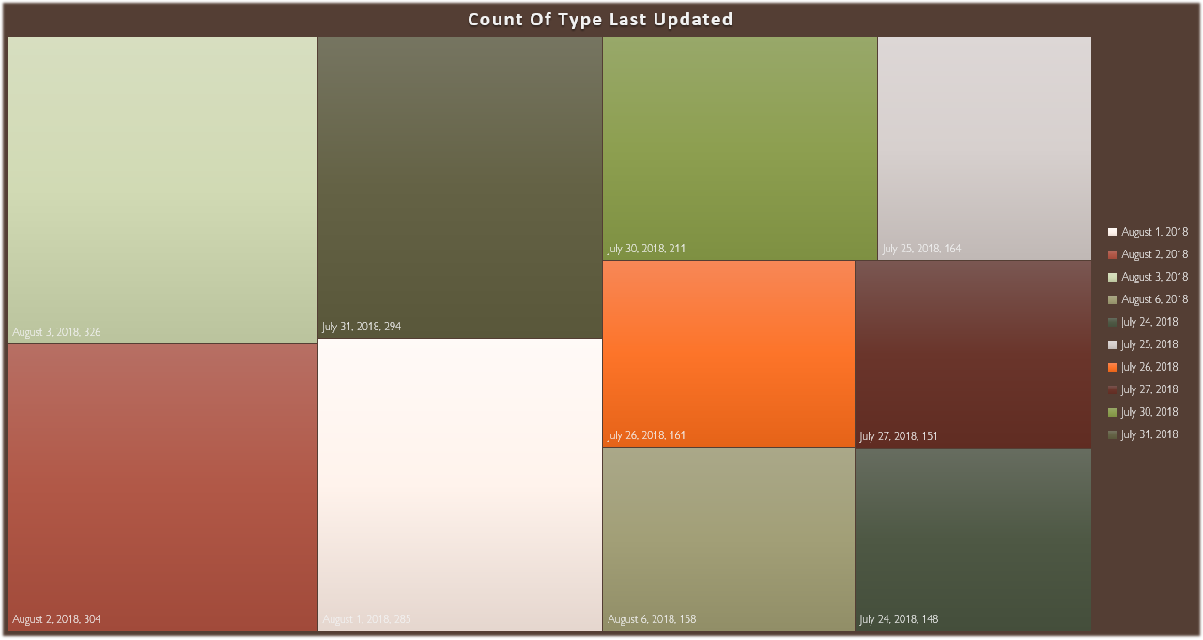
Count Of Type Last Updated - Tree – Map Chart

Slide 8
Percentage Of Price - Area Chart

Slide 9
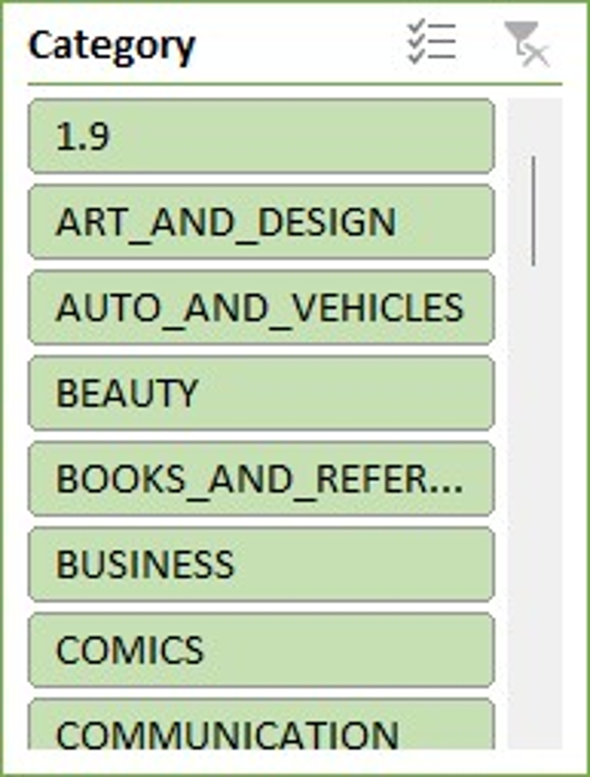
Slicers - Category Slicer

Slide 10
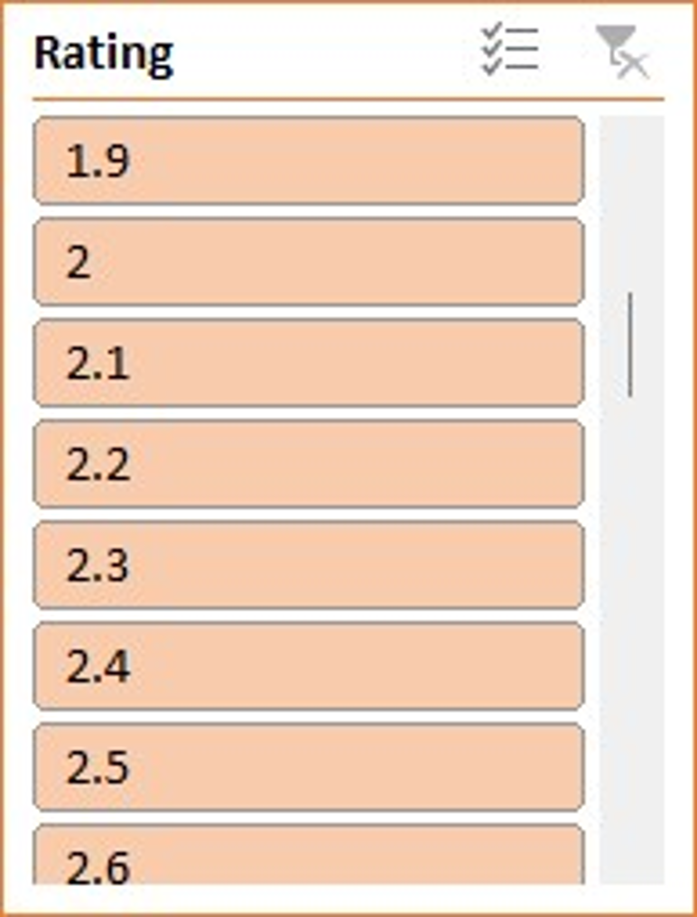
Slicers - Rating Slicer

Slide 11
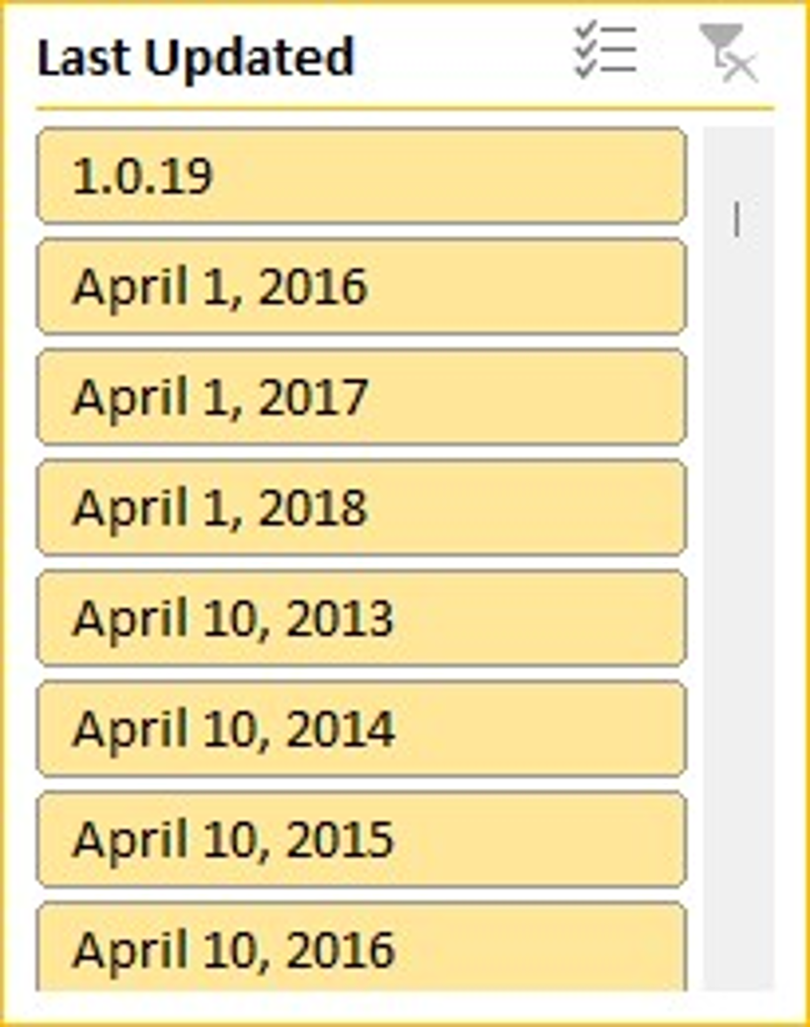
Slicers - Last Updated Slicer

Slide 12
Roblox App is the Highest Rating App.
Insights
Total App Rating is more for the Roblox i.e. 40.5
Categorywise count of Type & Price is 1972 for Family.

Slide 13
Insights
The Highest Percentage of Reviews of App is 172.71% for Facebook.
Percentage Of Content Rating is 17.12% for Tools Genre.
Roblox App have highest count of Android & Current
Version i.e. 9.

Slide 14
The Highest Percentage Of Price is 8.57% for Roblox App.
Insights -
The Last Updated Count Of Type is 326, for 3 Aug,
2018 date.

Slide 15
After Completion Of Analysis, I conducted that user prefer more of free Apps. & in Future also Free Apps are more preferred. Most of the apps, present in Playstore are more or less of same size so size doesn't affect their decision much.
Future Scope -
In Future, Google Playstore have Highest Rating of App Installers.
In all the App, the Facebook Reviews are more than the other App. The size of the App doesn't much matter still the installs are more.

Slide 16
In the Category, the family is major in use Free App, in which you will find Diff Genres,
like Educational, Entertainment are the use more.
Future Scope -
In Future also, the installers of the Google Playstore are increasing. The diff types
of apps are installs for diff kind of reasons. But the drawback is that the Children install the Games, & play the games for much time. From that, the deficiency in eyes are increasing in Children, it affects the Children's Health.
The Dataset contains Possibilities to deliver insights to understand Customer
Demands better & thus help developers to Popularize the Product.

Slide 17
Create Own Page -
I can take the Own data of Instagram App User in Google Playstore from 2020-2024 by Google.
& Make a Forecast Chart of that, for Future Scope.
I can take the Own data of Instagram App User in Google Playstore from 2020-2024 by Google.
& Make a Forecast Chart of that, for Future Scope.
Year | Instagram User
2020 | 170,000,000
2021 | 70,000,000
2022 | 70,000,000
2023 | 50,000,000
2024 | 40,000,000

Slide 18
Forecast Chart -
year | Instagram user | Forecast(Instagram user) | Lower Confidence Bound(Instagram user) | Upper Confidence Bound(Instagram user)
2020 | 170000000
2021 | 70000000
2022 | 70000000
2023 | 50000000
2024 | 40000000 | 40000000 | 40000000.00 | 40000000.00
2025 |  | 7521945.116 | -62103212.69 | 77147102.93
2026 |  | -19656389.95 | -91441278.27 | 52128498.37
2027 |  | -46834725.01 | -120732736.88 | 27063286.85
2028 |  | -74013060.08 | -149981541.65 | 1955421.49
2029 |  | -101191395.1 | -179191151.51 | -23191638.78
2030 |  | -128369730.2 | -208364612.88 | -48374847.54

Slide 19


